Slide 1


1. Starting
Python Workshop
By: Wameedh Scientific Club

Slide 2
0. Computers and Programs
A computer is a machine that stores data.
A program is a set of instructions that tells a computer what to do with the data.

Slide 3
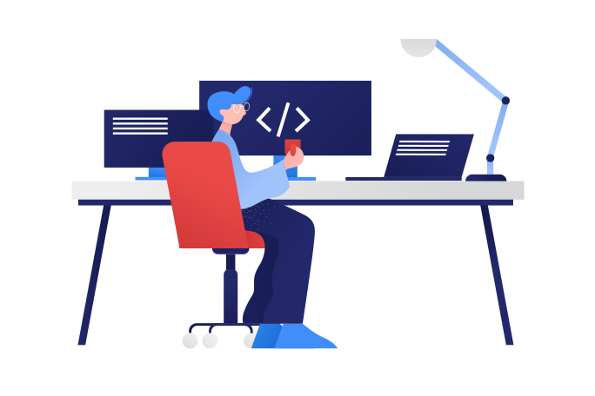
Why Learn to Program?
Makes you a clever user of computers
It's fun!
You make stuff (programs) that do things
Helps you learn problem solving skills
Programmers get jobs

Slide 4
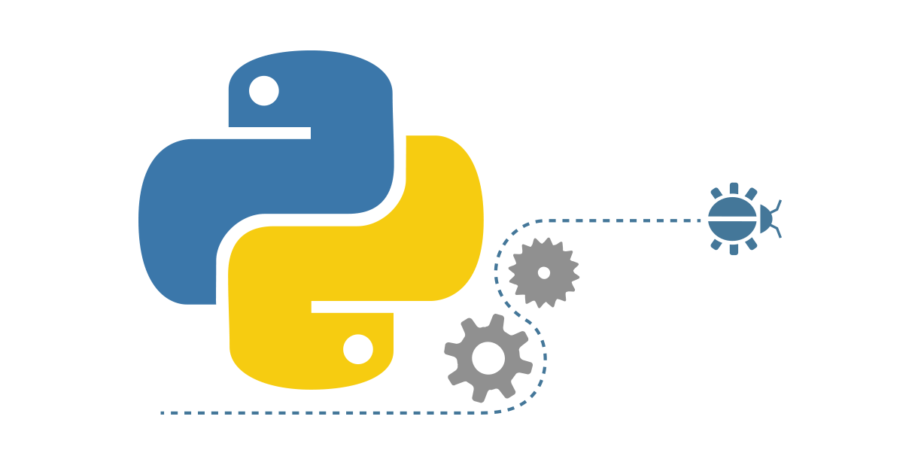
Why Learn Python?
The Python programming language is aimed at beginners
It's easy to learn and use
Powerful
Lots of program libraries
Free
Runs on everything
Lots of users; lots of help online
Used in the real world

Slide 5







Slide 6
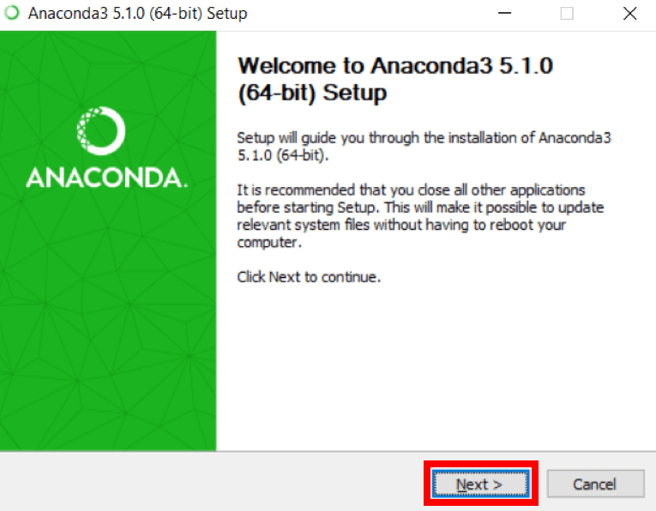
1. Install Anaconda (a Python Package Manager)

Slide 7
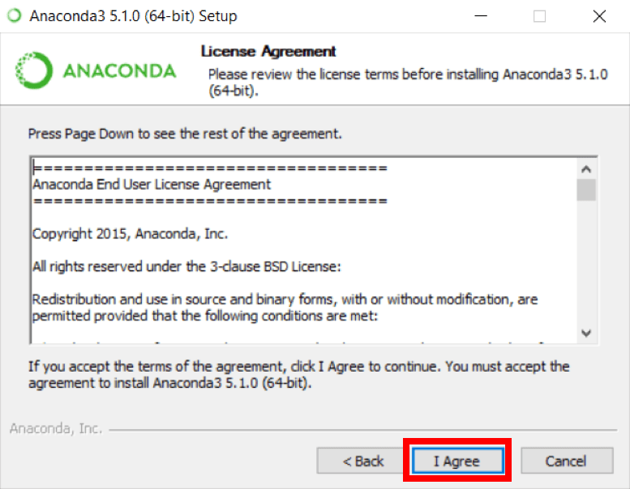

Slide 8
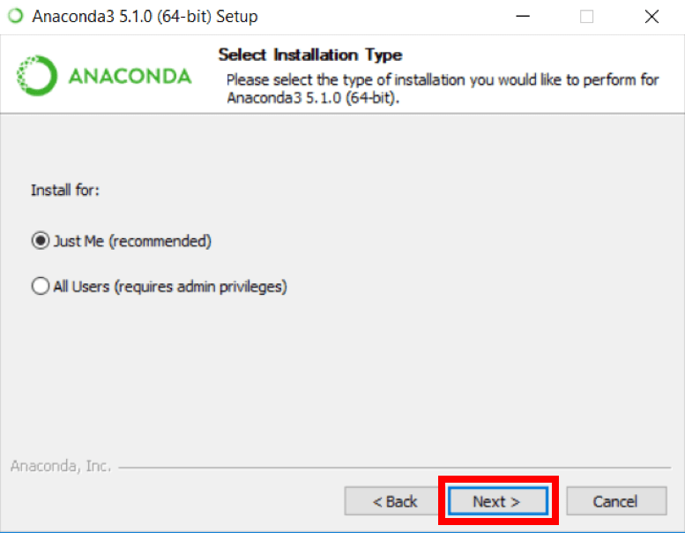

Slide 9
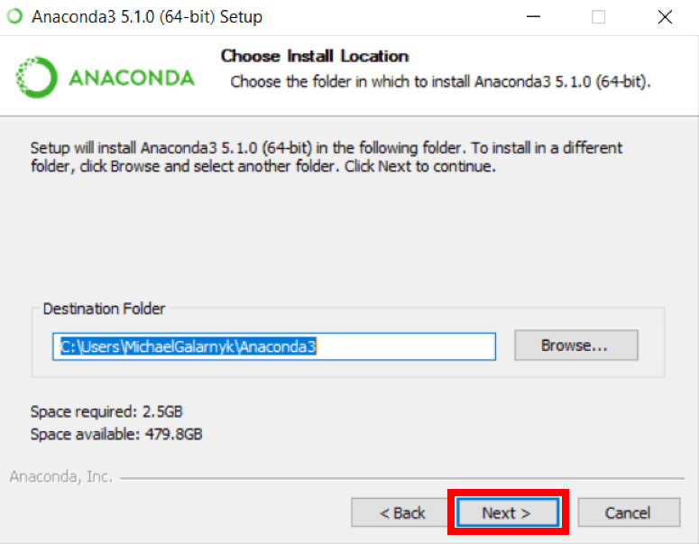

Slide 10
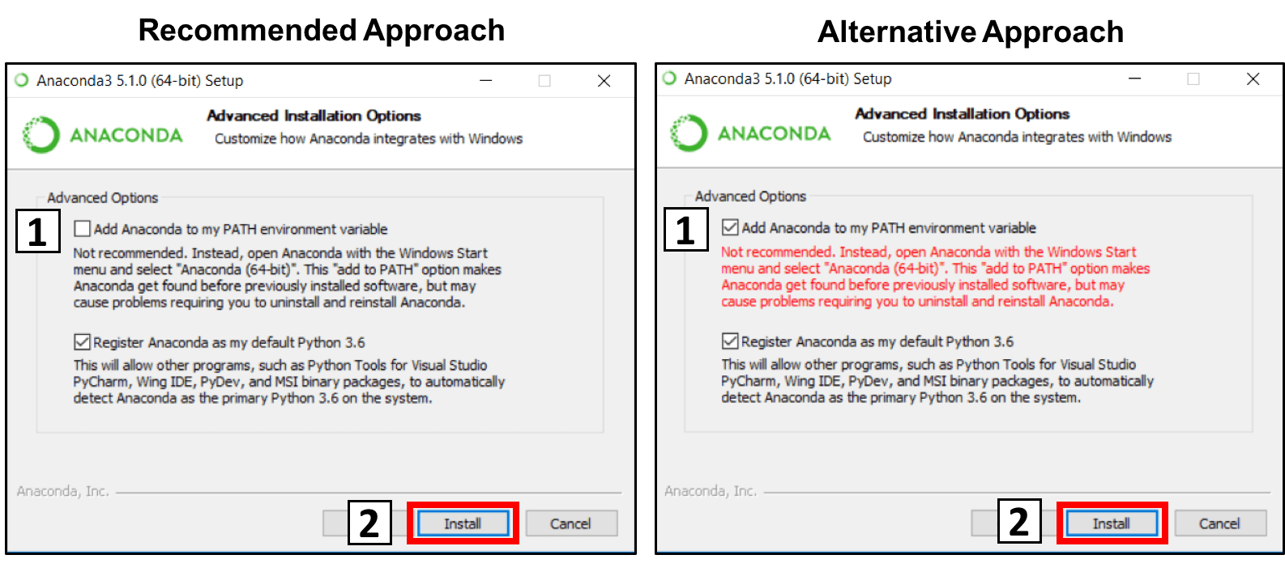

Slide 11
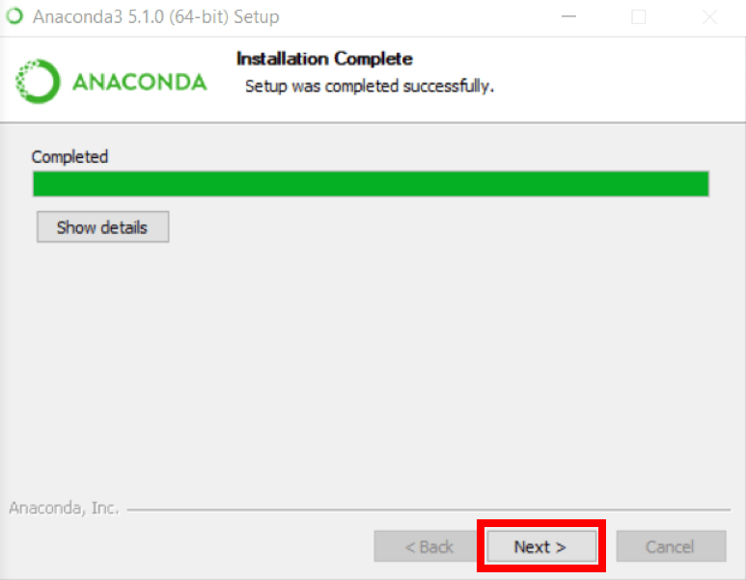

Slide 12
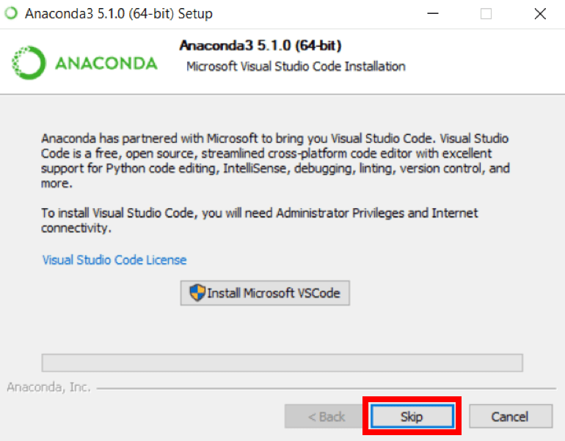

Slide 13
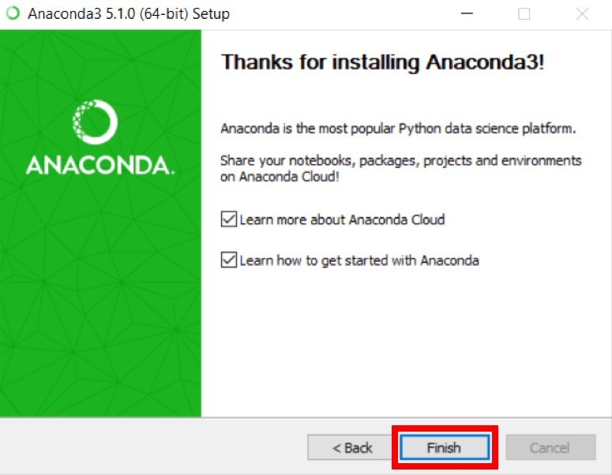

Slide 14
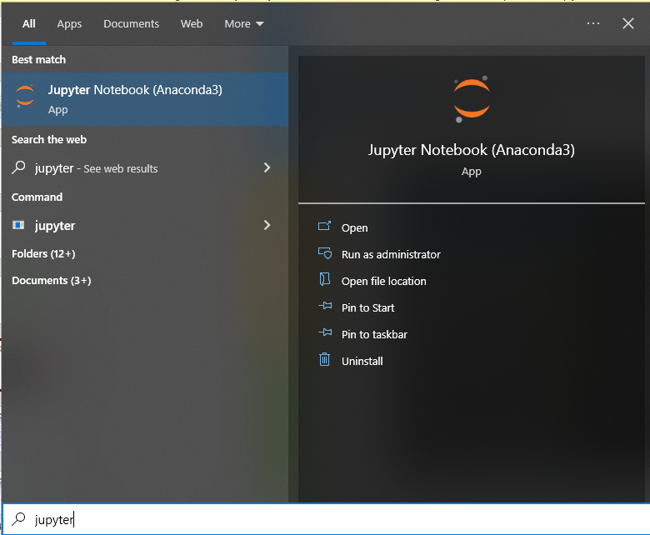
2. Start Jupyter Notebook (a Python editor)

Slide 15
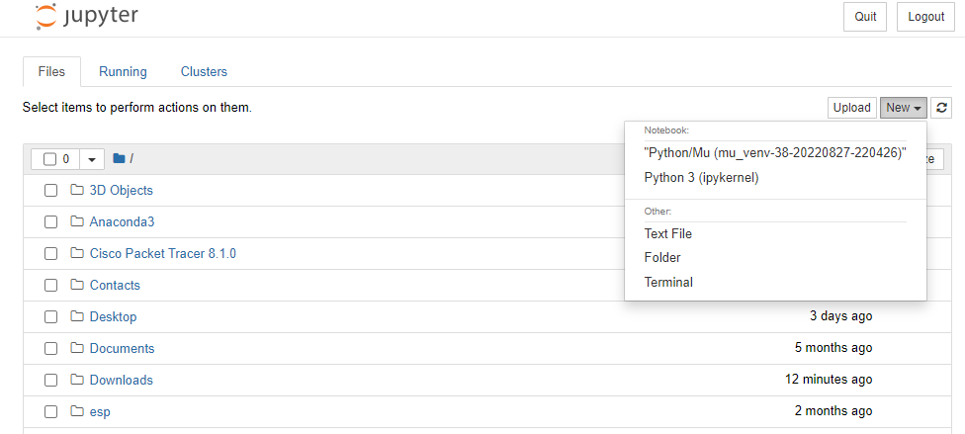
Inside Jupyter
We Choose New
And choose Python 3

Slide 16
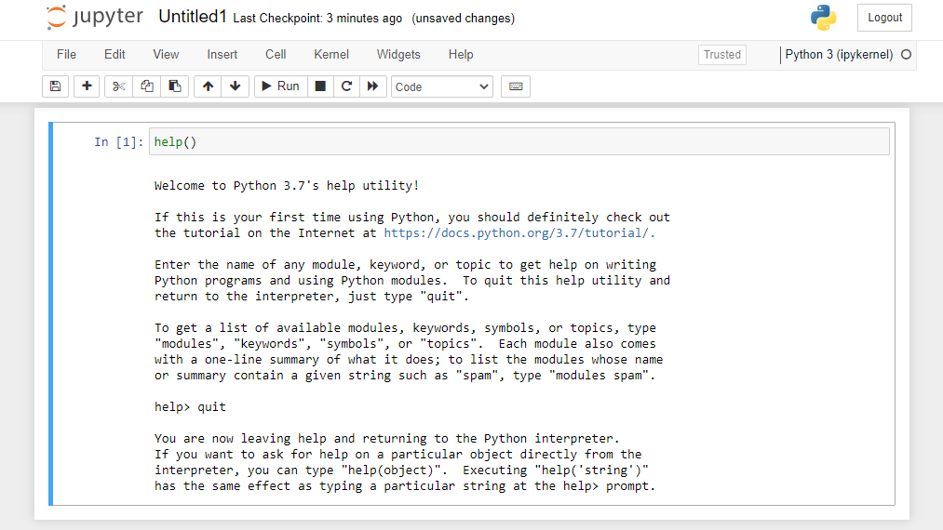
Inside Jupyter
I typed help() and <enter> to start "help"
I typed quit to leave "help" but still be in Jupyter

Slide 17
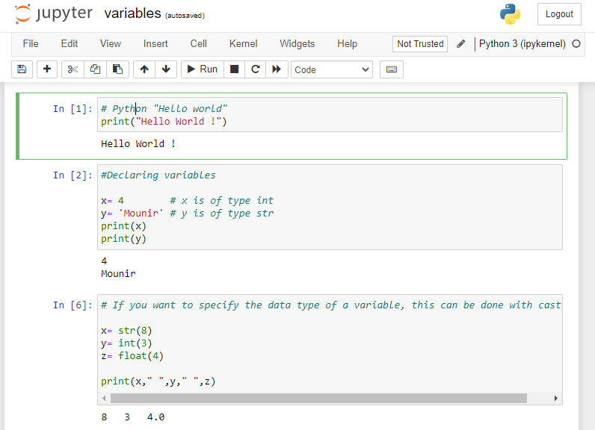
Get Python to do Things
We write on the cell and then click Run

Slide 18
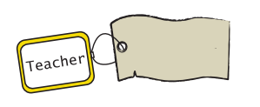
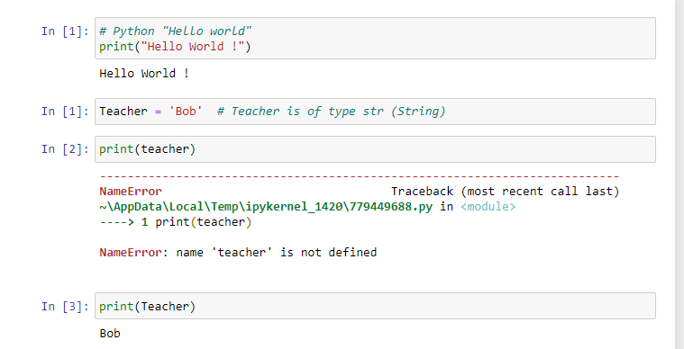
1. What is a Variable?
A variable is a "named tag" for data used in your programs
“Bob"
tag
data
Python treats the tag name
teacher as being a different
name than Teacher
"Teacher" is a string, not the
tag name Teacher

Slide 19
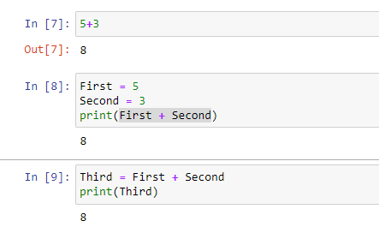
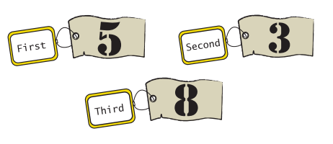
Variables Using Number Data

Slide 20
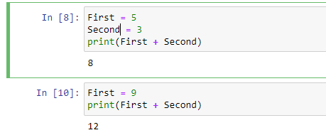

Why are they called "Variables"?
a variable can change
(the tag is given new data
5
9
first

Slide 21
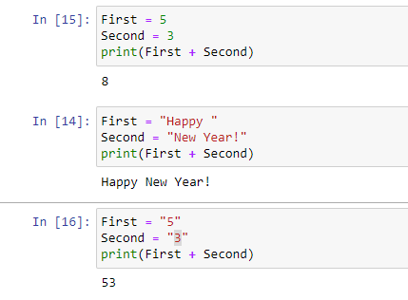
Numbers and Strings
+ means different things
for numbers and strings
strings can use "…" or '…'

Slide 22
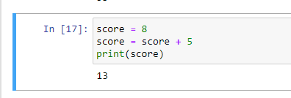
The New Me
the "new" score is the "old" score + 5

Slide 23
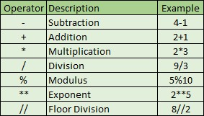
Some Math Operations
remainder
2 to the power 5
no fraction part
and ( ... ) around the maths, if you want

Slide 24
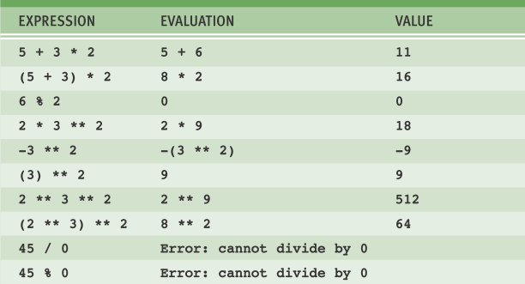
Some Maths to Try

Slide 25
Let’s do some coding!

Slide 26
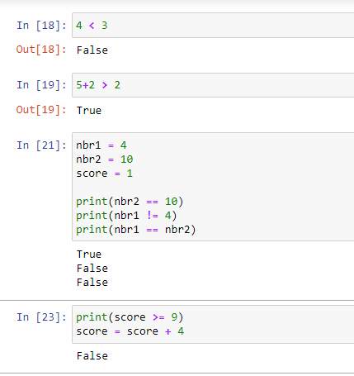
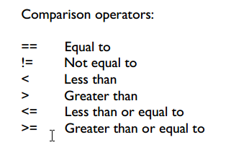

Slide 27
4. Writing a Python Program
1. Start Jupyter
2. Create a new program file
3. Write a Python program into the file
4. Save the program file.
give the file a name, e.g. test1
5. Check the file is on your PC

Slide 28
4. Writing a Python Program
1. Start Jupyter
2. Create a new program file
3. Write a Python program into the file
4. Save the program file.
give the file a name, e.g. test1
5. Check the file is on your PC

Slide 29
If statement: test, action(s)
If Yacine got the right answer, add 1 point to his score.
If Nassim had a wrong answer, punish him.
If the file isn’t there, display an error message.

Slide 30
"If" Flowchart
If Yacine got the right answer, add 1 point to his score.
executing program
Test:
Did Yacine get the right score?
no
yes
Action: Add 1 point
to his score
execution continues...

Slide 31
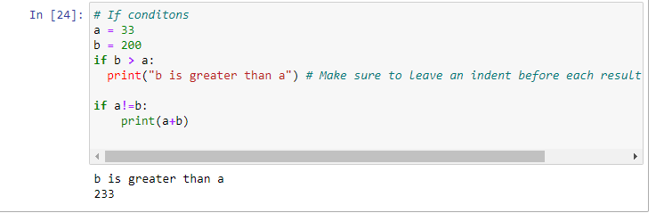
Code details
test: is b > a?
actions must be
indented (add 4 spaces
at the start of each line)

Slide 32
Flowchart
executing program
Test:
b > a?
no
yes
Action: print b is
greater than a
execution continues...

Slide 33
Let’s try that!

Slide 34


